Slide 1
Lecture 4:
Backpropagation
and
Neural Networks part 1

Slide 2
Administrative
A1 is due Jan 20 (Wednesday). ~150 hours left
Warning: Jan 18 (Monday) is Holiday (no class/office hours)
Also note:
Lectures are non-exhaustive.
Read course notes for completeness.
I’ll hold make up office hours on Wed Jan20, 5pm @ Gates 259

Slide 3
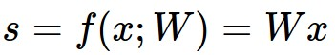

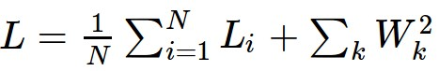
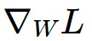
Where we are...
scores function
SVM loss
data loss + regularization
want

Slide 4

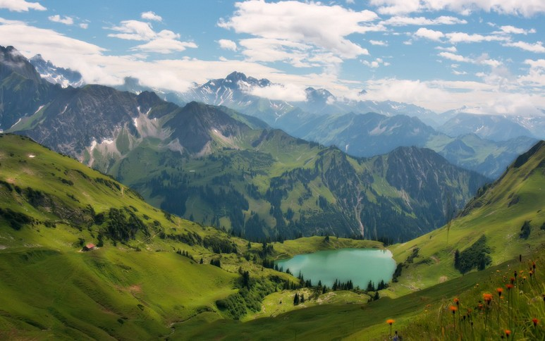

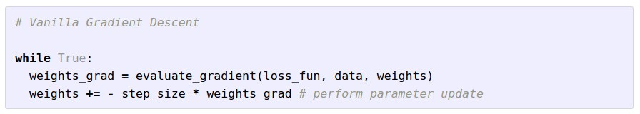
Optimization
(image credits
to Alec Radford)

Slide 5
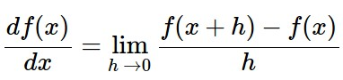
Gradient Descent
Numerical gradient: slow :(, approximate :(, easy to write :)
Analytic gradient: fast :), exact :), error-prone :(
In practice: Derive analytic gradient, check your implementation with numerical gradient

Slide 6
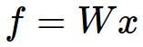
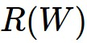
Computational Graph
x
*
s (scores)
hinge loss
+
L
W
R

Slide 7

Convolutional Network
(AlexNet)
input image
weights
loss

Slide 8
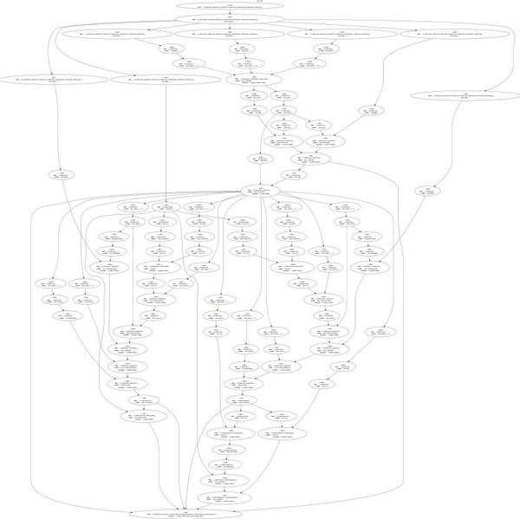
Neural Turing Machine
input tape
loss

Slide 9
Neural Turing Machine

Slide 10
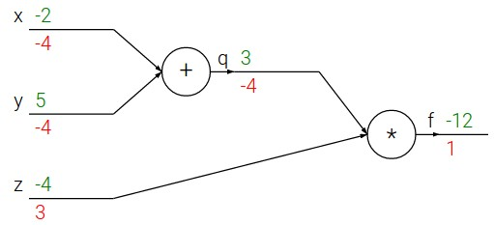
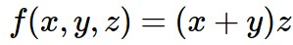
e.g. x = -2, y = 5, z = -4

Slide 11
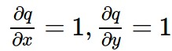
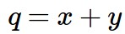
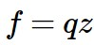
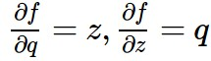
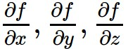
e.g. x = -2, y = 5, z = -4
Want:

Slide 12
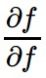
e.g. x = -2, y = 5, z = -4
Want:

Slide 13
e.g. x = -2, y = 5, z = -4
Want:

Slide 14
e.g. x = -2, y = 5, z = -4
Want:

Slide 15
e.g. x = -2, y = 5, z = -4
Want:

Slide 16
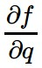
e.g. x = -2, y = 5, z = -4
Want:

Slide 17
e.g. x = -2, y = 5, z = -4
Want:

Slide 18
e.g. x = -2, y = 5, z = -4
Want:

Slide 19
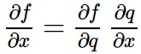
e.g. x = -2, y = 5, z = -4
Chain rule:
Want:

Slide 20
e.g. x = -2, y = 5, z = -4
Want:

Slide 21
e.g. x = -2, y = 5, z = -4
Chain rule:
Want:

Slide 22
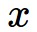
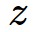
activations
f

Slide 23
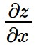
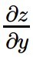
activations
f
“local gradient”

Slide 24
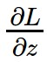
activations
f
“local gradient”
gradients

Slide 25
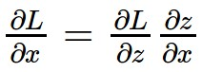
activations
f
“local gradient”
gradients

Slide 26
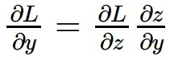
activations
f
“local gradient”
gradients

Slide 27
activations
f
“local gradient”
gradients

Slide 28
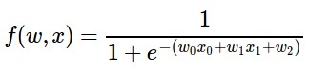
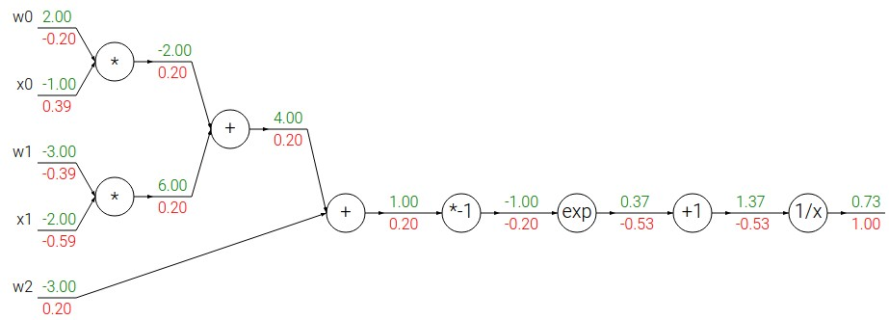
Another example:

Slide 29
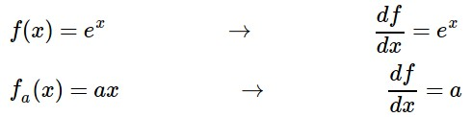
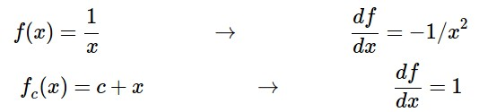
Another example:

Slide 30
Another example:

Slide 31
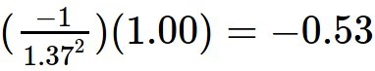
Another example:

Slide 32
Another example:

Slide 33
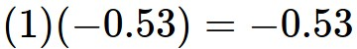
Another example:

Slide 34
Another example:

Slide 35
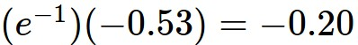
Another example:

Slide 36
Another example:

Slide 37
Another example:
(-1) * (-0.20) = 0.20

Slide 38
Another example:

Slide 39
Another example:
[local gradient] x [its gradient]
[1] x [0.2] = 0.2
[1] x [0.2] = 0.2 (both inputs!)

Slide 40
Another example:

Slide 41
Another example:
[local gradient] x [its gradient]
x0: [2] x [0.2] = 0.4
w0: [-1] x [0.2] = -0.2

Slide 42
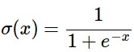
sigmoid function
sigmoid gate

Slide 43
sigmoid function
sigmoid gate
(0.73) * (1 - 0.73) = 0.2

Slide 44
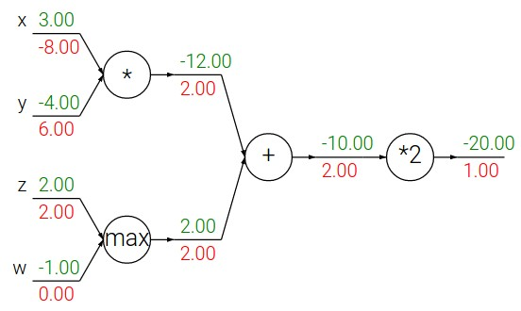
Patterns in backward flow
add gate: gradient distributor
max gate: gradient router
mul gate: gradient… “switcher”?

Slide 45
Gradients add at branches
+

Slide 46
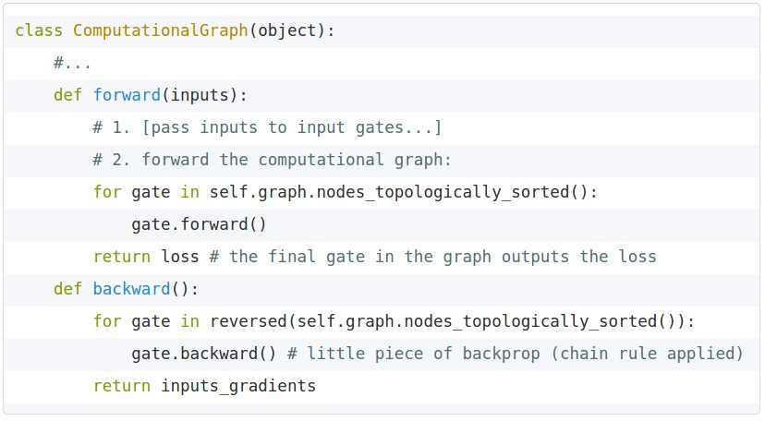
Implementation: forward/backward API
Graph (or Net) object. (Rough psuedo code)

Slide 47
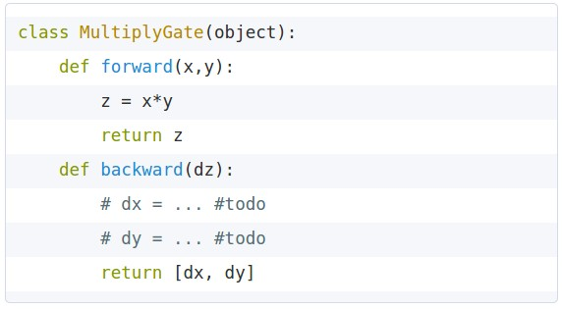
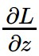
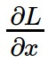
Implementation: forward/backward API
x
z
*
y
(x,y,z are scalars)

Slide 48
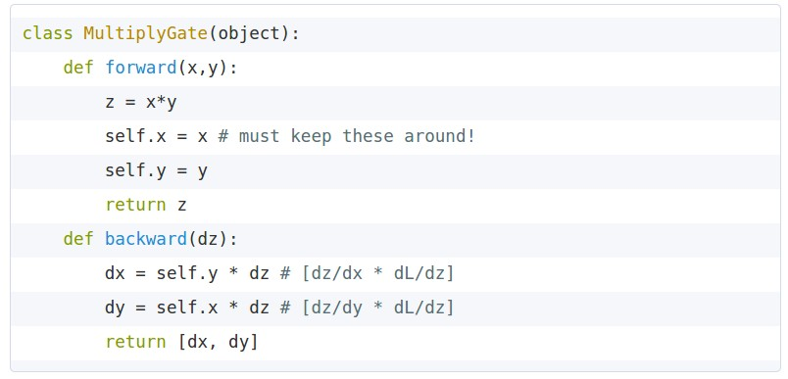
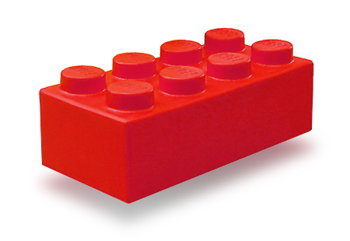
Implementation: forward/backward API
x
z
*
y
(x,y,z are scalars)

Slide 49
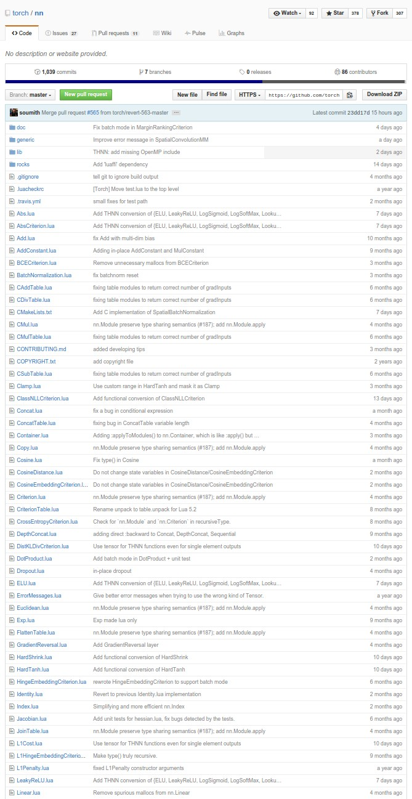
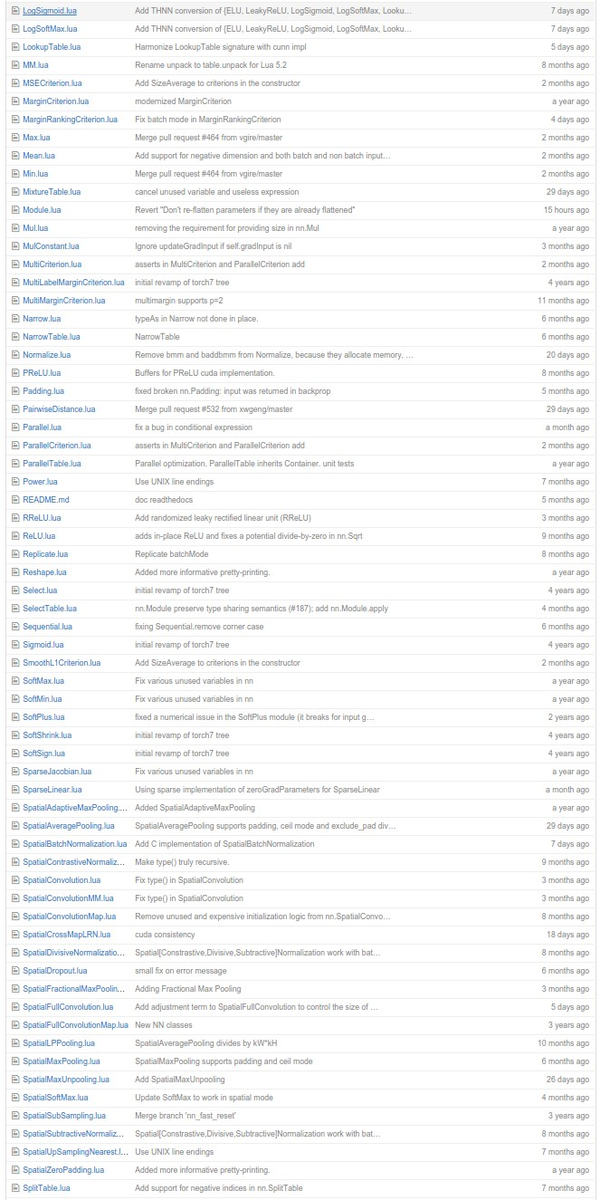
Example: Torch Layers

Slide 50
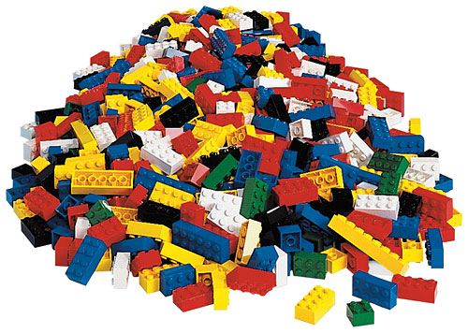
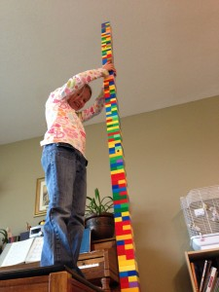
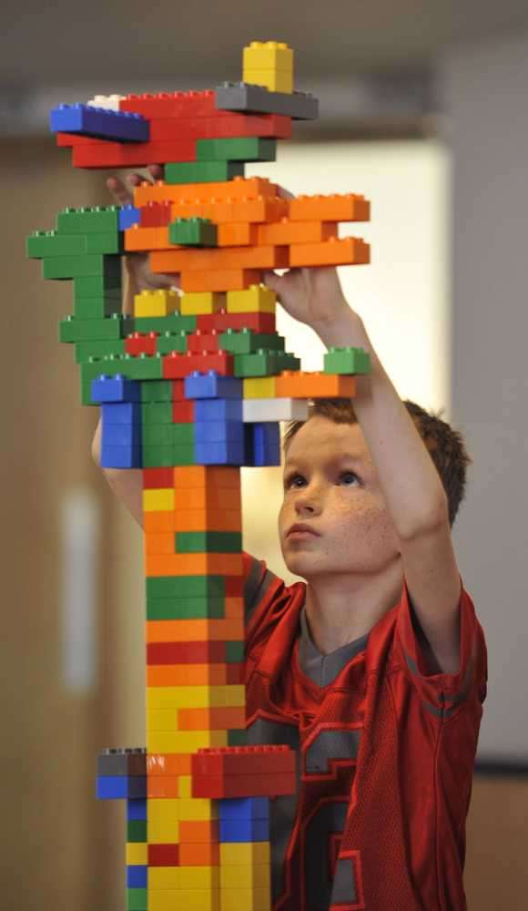
Example: Torch Layers
=

Slide 51
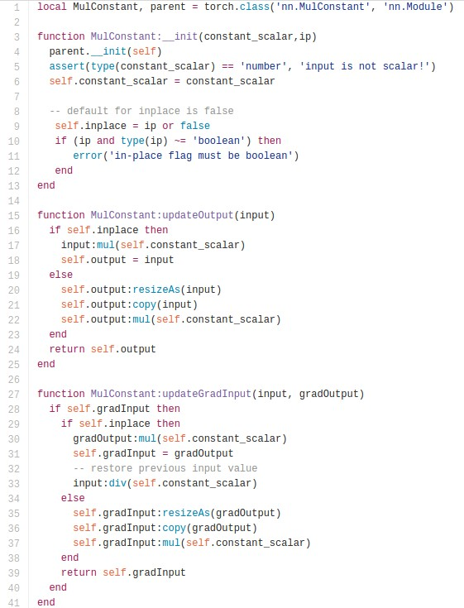
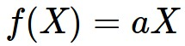
Example: Torch MulConstant
initialization
forward()
backward()

Slide 52
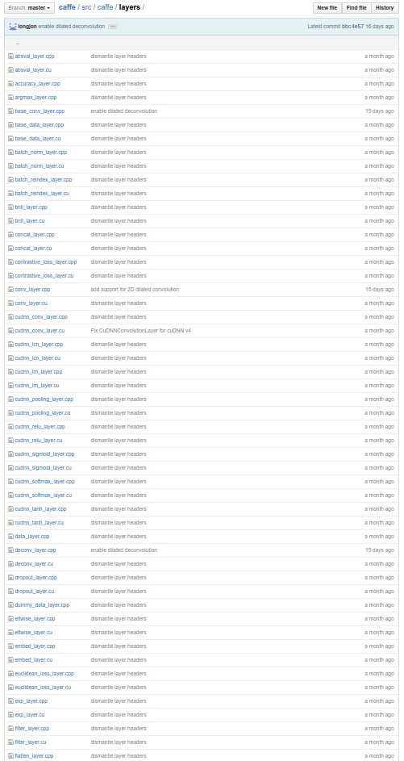
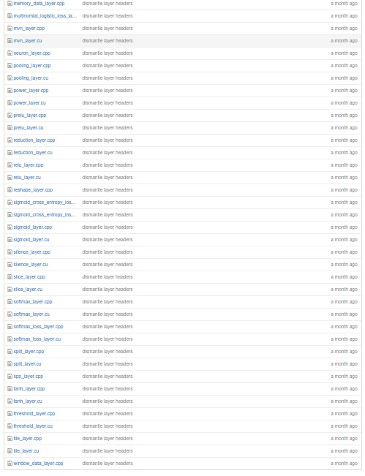
Example: Caffe Layers

Slide 53

Caffe Sigmoid Layer
*top_diff (chain rule)

Slide 54
Gradients for vectorized code
(x,y,z are now vectors)
This is now the Jacobian matrix (derivative of each element of z w.r.t. each element of x)
f
“local gradient”
gradients

Slide 55
Vectorized operations
f(x) = max(0,x)
(elementwise)
4096-d
input vector
4096-d
output vector

Slide 56

Vectorized operations
Jacobian matrix
f(x) = max(0,x)
(elementwise)
4096-d
input vector
4096-d
output vector
Q: what is the size of the Jacobian matrix?

Slide 57
Vectorized operations
Jacobian matrix
max(0,x)
(elementwise)
f(x) = max(0,x)
(elementwise)
4096-d
input vector
4096-d
output vector
Q: what is the size of the Jacobian matrix?
[4096 x 4096!]
Q2: what does it look like?

Slide 58
Vectorized operations
in practice we process an entire minibatch (e.g. 100) of examples at one time:
max(0,x)
(elementwise)
f(x) = max(0,x)
(elementwise)
100 4096-d
input vectors
100 4096-d
output vectors
i.e. Jacobian would technically be a
[409,600 x 409,600] matrix :\

Slide 59


Assignment: Writing SVM/Softmax
Stage your forward/backward computation!
margins
E.g. for the SVM:

Slide 60
Summary so far
neural nets will be very large: no hope of writing down gradient formula by hand for all parameters
backpropagation = recursive application of the chain rule along a computational graph to compute the gradients of all inputs/parameters/intermediates
implementations maintain a graph structure, where the nodes implement the forward() / backward() API.
forward: compute result of an operation and save any intermediates needed for gradient computation in memory
backward: apply the chain rule to compute the gradient of the loss function with respect to the inputs.

Slide 61


Slide 62

Neural Network: without the brain stuff
(Before) Linear score function:

Slide 63

Neural Network: without the brain stuff
(Before) Linear score function:
(Now) 2-layer Neural Network

Slide 64
Neural Network: without the brain stuff
(Before) Linear score function:
(Now) 2-layer Neural Network
x
h
W1
W2
s
3072
100
10

Slide 65

Neural Network: without the brain stuff
(Before) Linear score function:
(Now) 2-layer Neural Network
x
h
W1
W2
s
3072
100
10

Slide 66
Neural Network: without the brain stuff
(Before) Linear score function:
(Now) 2-layer Neural Network
or 3-layer Neural Network

Slide 67

Full implementation of training a 2-layer Neural Network needs ~11 lines:
from @iamtrask, http://iamtrask.github.io/2015/07/12/basic-python-network/

Slide 68

Assignment: Writing 2layer Net
Stage your forward/backward computation!

Slide 70


Slide 71


Slide 72


Slide 73


sigmoid activation function

Slide 74


Slide 75

Be very careful with your Brain analogies:
Biological Neurons:
Many different types
Dendrites can perform complex non-linear computations
Synapses are not a single weight but a complex non-linear dynamical system
Rate code may not be adequate
[Dendritic Computation. London and Hausser]

Slide 76








Activation Functions
Leaky ReLU
max(0.1x, x)
Sigmoid
Maxout
tanh tanh(x)
ELU
ReLU max(0,x)

Slide 77


Neural Networks: Architectures
“3-layer Neural Net”, or
“2-hidden-layer Neural Net”
“2-layer Neural Net”, or
“1-hidden-layer Neural Net”
“Fully-connected” layers

Slide 78
Example Feed-forward computation of a Neural Network
We can efficiently evaluate an entire layer of neurons.

Slide 79

Example Feed-forward computation of a Neural Network

Slide 80

Setting the number of layers and their sizes
more neurons = more capacity

Slide 81

Do not use size of neural network as a regularizer. Use stronger regularization instead:
(you can play with this demo over at ConvNetJS: http://cs.stanford.edu/people/karpathy/convnetjs/demo/classify2d.html)

Slide 82
Summary
we arrange neurons into fully-connected layers
the abstraction of a layer has the nice property that it allows us to use efficient vectorized code (e.g. matrix multiplies)
neural networks are not really neural
neural networks: bigger = better (but might have to regularize more strongly)

Slide 83
Next Lecture:
More than you ever wanted to know about Neural Networks and how to train them.

Slide 84

complex graph
inputs x
outputs y
reverse-mode differentiation (if you want effect of many things on one thing)
for many different x
forward-mode differentiation (if you want effect of one thing on many things)
for many different y

